Slide 1
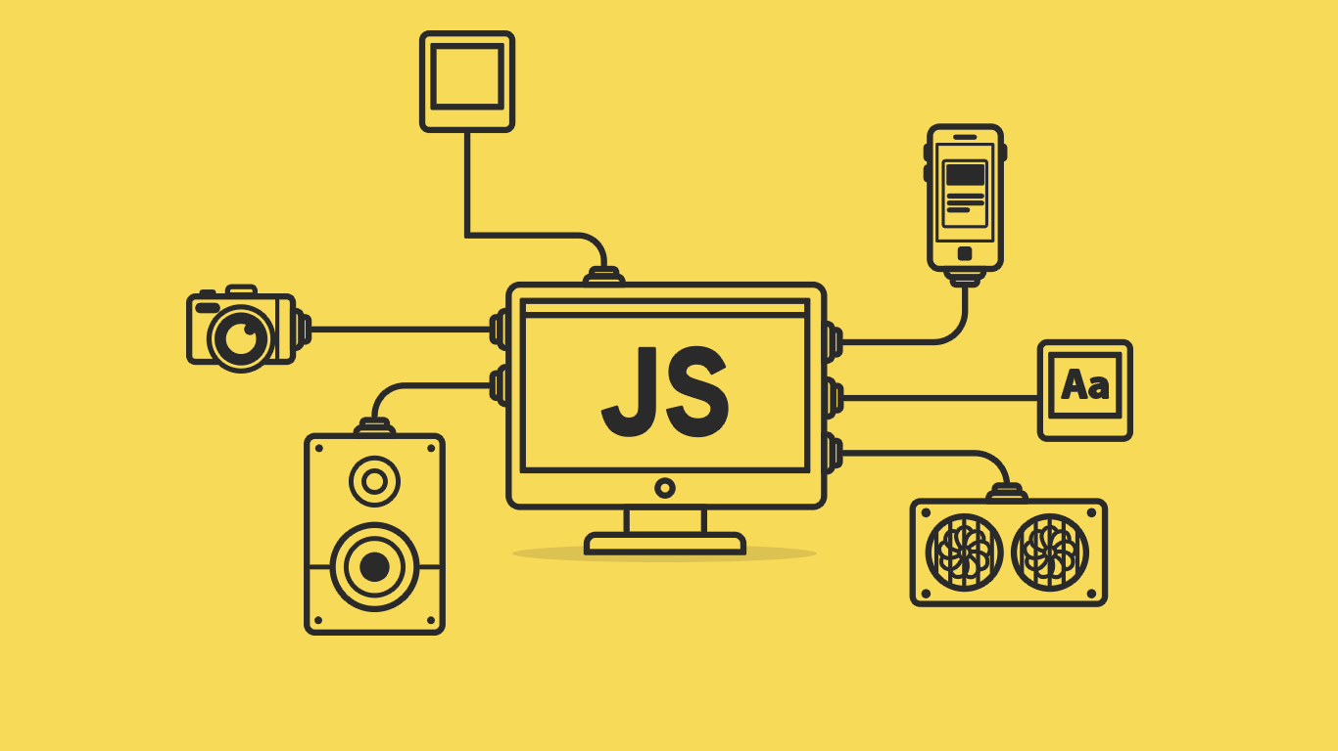

Slide 2
About today…
Control Statements
if-else
switch

Slide 3
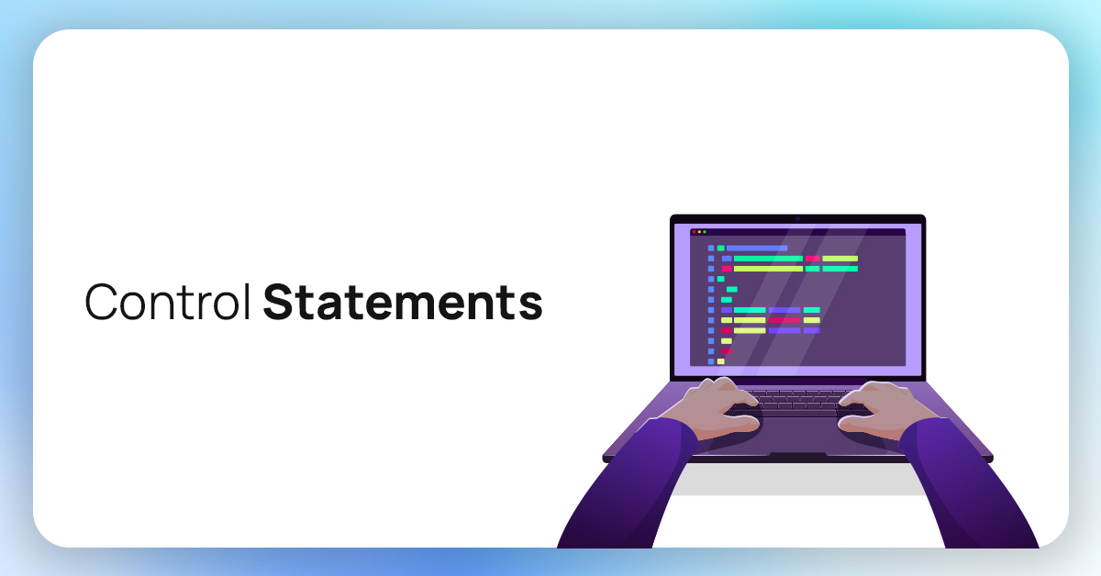

Slide 4
Intro to Control Statements
Definition
Control statements allow you to dictate the flow of execution in your programs
based on conditions
Types
if/else Statements
switch Statements
Importance
Understanding control statements is crucial for making decisions in your code

Slide 5



if Statement
Definition
Block of code executes ONLY when the given condition is true
Syntax
Example

Slide 6
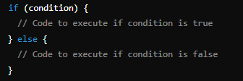
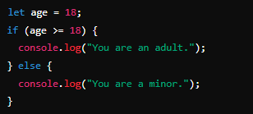
if-else Statement
Definition
First block of code executes when the given condition is true, otherwise second
(else) block is executed
Syntax
Example

Slide 7
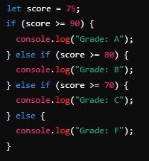
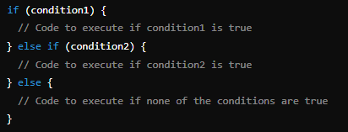
if - else if - else Statement
Definition
The first true yielding block is executed, and if there is no true condition, then
else block is executed
Example
Syntax

Slide 8
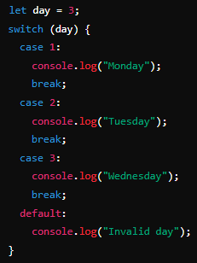
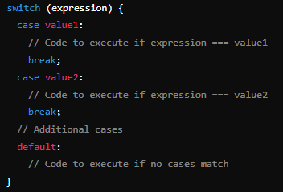
Switch Statement
Definition
The body of first matching case is executed, and if no such case is found, then
default block body is executed
Example
Syntax

Slide 9


Slide 10

What does the break keyword do in a switch statement? Why is it important?
What is one challenge you might face when using many if statements in a row?
What is the correct comparison operator to check if a variable x is equal to 10

Slide 11

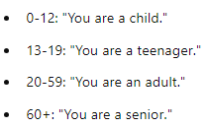
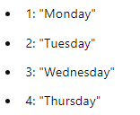
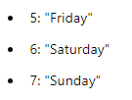
Task 1
Write a program that takes a user's age as input and prints a different message for each age group
Task 2
Write a program that takes a number from 1 to 7 as input and prints the corresponding day of the week using a switch statement

